Slide 1
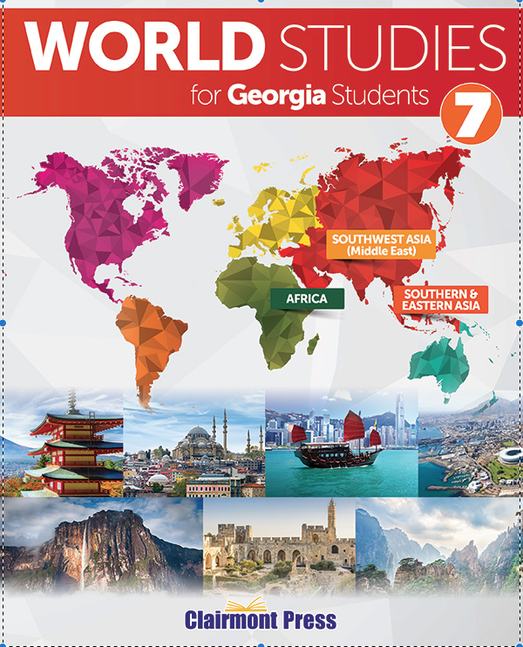
REPUBLIC OF
TURKEY WRAP-UP
To play the game, go to the next slide and click on a point value to go to a question.
To go to final Wrap-Up click on Final Wrap-Up at the bottom of the main screen.

Slide 2
Geography
History
Government
Economy
US/Turkey
Relations
Vocabulary
100
100
100
100
100
100
200
200
200
200
200
200
300
300
300
300
300
300
400
400
400
400
400
400
500
500
500
500
500
500

Slide 3
Team 1
Team 2
Team 3
Team 4
Team 5
Wager
Wager
Wager
Wager
Wager
Final
Wrap-Up
board

Slide 4
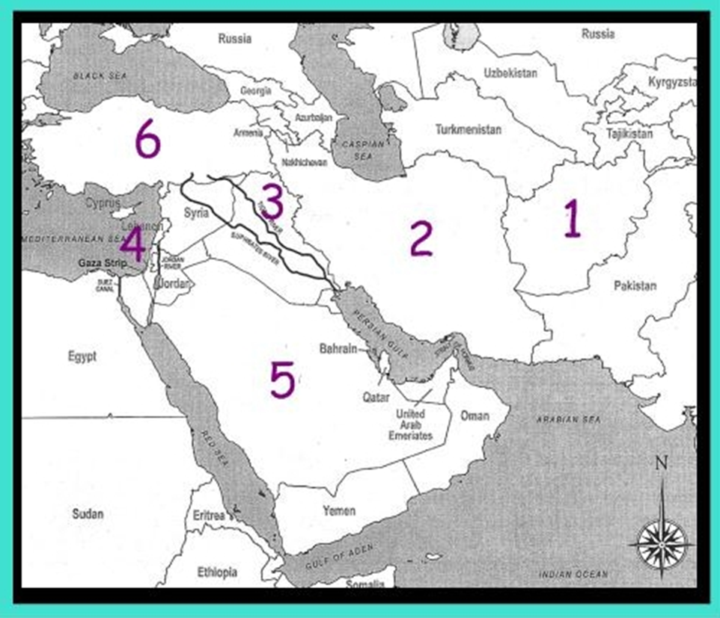
What country is labeled as #6?

Slide 5
The country of Turkey
board
score

Slide 6
What two seas border Turkey?

Slide 7
Black Sea and Mediterranean Sea
board
score

Slide 8
Name the two continents in which Turkey is divided.

Slide 9
Europe
Asia
board
score

Slide 10
What are two major rivers in Turkey?

Slide 11
Euphrates
Tigris
board
score

Slide 12
Turkey ranks 1st in mining what natural stone?

Slide 13
Marble
board
score

Slide 14
What did the Ottomans rename Constantinople?

Slide 15
Istanbul
board
score

Slide 16
What mistake did the Ottoman Empire make in World War I?

Slide 17
They made the mistake of allying with Germany and the Austro-Hungarian Empire.
board
score

Slide 18
What ended the Ottoman Empire in 1918?

Slide 19
Mudros Armistice
board
score

Slide 20
What was the purpose of the Lausanne Peace Treaty in 1923?

Slide 21
The treaty created an independent Turkish country.
board
score

Slide 22
Name at least 3 ways Mustafa helped to modernize Turkey.

Slide 23
Disbanded religious schools
Ended Islamic law
Helped write a constitution separating religion and government
Changed Turkish alphabet from Arabic to Latin
Introduced the idea of surnames to the Turkish people
board
score

Slide 24
What type of government does Turkey have?

Slide 25
Parliamentary democracy
board
score

Slide 26
At what age are citizens allowed to vote?

Slide 27
Age 18 or older
board
score

Slide 28
When a government is secular, what is separated?

Slide 29
Religion and government
are separate.
board
score

Slide 30
What makes up Turkey’s executive branch?

Slide 31
The head of state
The head of government
The cabinet
board
score

Slide 32
How many members are on the the Constitutional Court and how are they chosen?

Slide 33
3 members are appointed by the Brand National Assembly.
14 are appointed by the president.
board
score

Slide 34
On what three things does Turkey base its GDP?

Slide 35
Industry
Services
Agriculture
board
score

Slide 36
Why is Turkey’s economy still struggling?

Slide 37
Decreased demand for Turkish goods in Europe.
Economy still struggles with corruption.
board
score

Slide 38
Why is free trade so important to Turkey’s economy?

Slide 39
Turkey’s location is a crossroads for trade.
board
score

Slide 40
What is one of the most important natural resources in Turkey?

Slide 41
Arable land or agriculture
board
score

Slide 42
Name the top five industries in Turkey.

Slide 43
Automobiles
Electronics
Mining
Steel
Lumber
board
score

Slide 44
How has Turkey significantly helped with the war in Afghanistan?

Slide 45
Turkey provides transport through the Incirlik Air Base.
board
score

Slide 46
What is the main focus of Turkey’s alliance with the United States?

Slide 47
Fighting terrorism
board
score

Slide 48
What are three main ways the US has assisted Turkey?

Slide 49
Security
Cooperation with neighboring countries
democracy
board
score

Slide 50
Name at least 3 items Turkish businesses buy from Georgia.

Slide 51
Cotton
Paper
Wood pulp
Aircraft
Motor vehicles
board
score

Slide 52
What American automobile company has a plant in Turkey and in what city is it located?

Slide 53
Ford
Izmit in the Anatolia region
board
score

Slide 54
What is the fertile crescent?

Slide 55
The land between the Tigris and Euphrates Rivers
board
score

Slide 56
Define coup.

Slide 57
A sudden overthrow of a government by a country’s military leaders or another small, powerful group
board
score

Slide 58
What is the Truman Doctrine?

Slide 59
A doctrine supporting free people and ensuring Turkey would not become communist
board
score

Slide 60
What is a reservoir?

Slide 61
An artificial lake created by construction of dams
board
score

Slide 62
What is lira?

Slide 63
Turkey’s
currency
board
score

Slide 64
Final
Wrap-Up
Make your wager on the scoreboard
Final Question
score

Slide 65
Identify the two groups ISIS and ISIL.

Slide 66
ISIS stands for Islamic State for Iraq and Syria.
ISIL stands for Islamic State in Iraq and the new Levant.
board
score

